Slide 1
Introduction to Stochastic Models I
Cristina Lanzas and Shi Chen
CBS 810 Infectious disease modeling

Slide 2
Learning objectives
Transit from deterministic to stochastic perspective
Understand basic types of stochasticity in disease transmission models
Understand demographic stochasticity
Learn chain-bonimal model

Slide 3
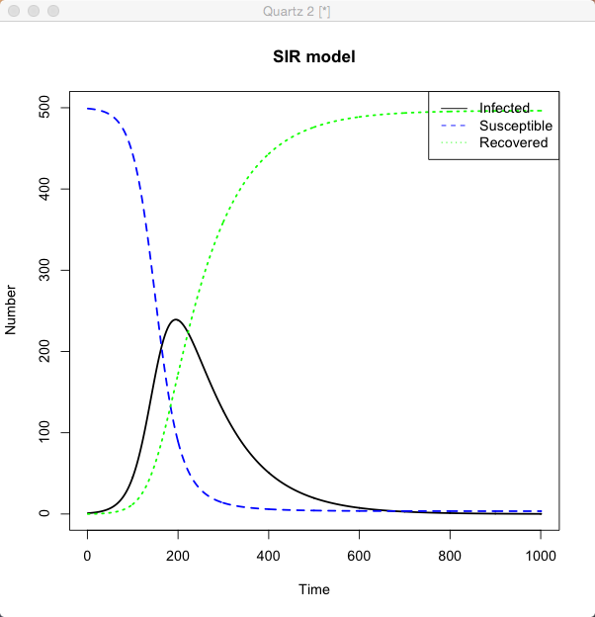
From Deterministic to Stochastic
Deterministic Model:
Results determined by:
Model structure
Parameter values
Initial condition
Example: SIR model

Slide 4
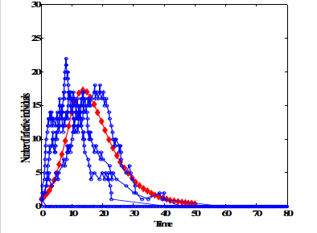
From Deterministic to Stochastic
Stochastic Model:
Results determined by:
Model structure
Parameter values
Initial condition
PROBABILITY

Slide 5
Types of Stochasticity
Demographic stochasticity: arises from the random nature of events at the individual level. More important for small populations.
Environmental stochasticity: arises from external sources. Equally important for small and large populations, and affects more than one individual at a time.
Observational stochasticity: arises from observational errors. Recall our discussion on model precision and accuracy.

Slide 6
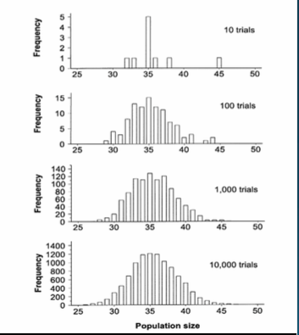
Demographic Stochasticity
Important in small populations:
Farms, hospitals, and households
Few infected individuals:
Early phase of outbreak
(invasion phase)
Late phase of outbreak
(extinction phase)
Notes:
Big data: buzz word. How a bout small data?

Slide 7
Types of Stochastic Models for Demographic Stochasticity
Discrete-Time Markov Chain (DTMC)
discrete time steps
chain-binomial models
Continuous-Time Markov Chain (CTMC)
continuous time steps
Gillespie’s models

Slide 8
Markov Models
A Markov model is a stochastic process/model in which transitions depends only on the most recent state, and not on any previous states:
Given the present, the future is independent of the past.
Prediction of tomorrow’s weather based on today’s condition
Prediction of tomorrow’s weather based on the past week’s condition

Slide 9
Transition Probability
The transition probability that a system is in state x(t) at time t given that it was in state x(t-1) at time t-1, is written as:
P(X(t)=x(t)|X(t-1)=x(t-1))
S
I
Notes:
Write down the transition matrix

Slide 10
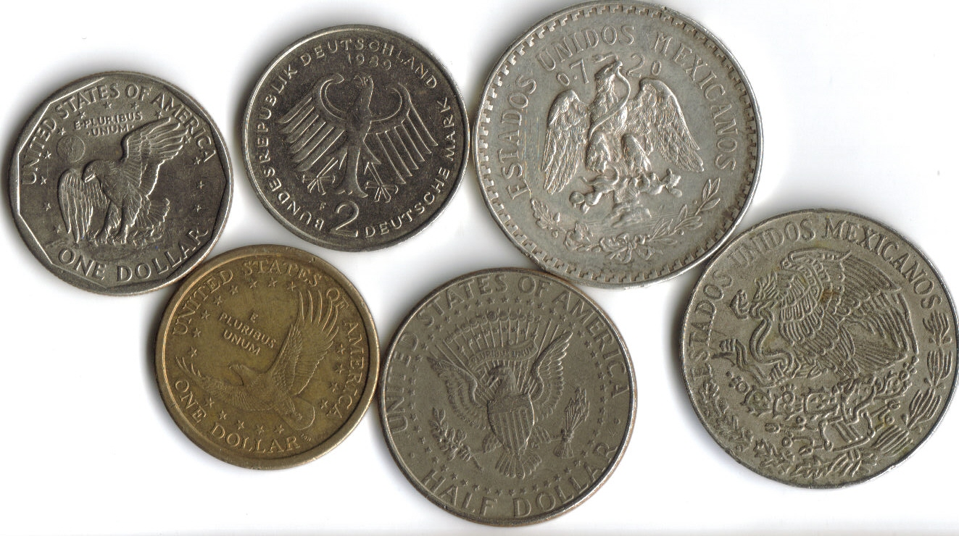
From Bernoulli to Binomial
Bernoulli trial:
Head or Tails (in 1 single coin-toss)
f(h)=p; f(t)=q=1-p
Binomial experiment:
Head or Tails (in n coin-tosses)
f(n,k)=C(n,k)*p^k*(1-p)^n-k
k: number of heads

Slide 11
Chain Binomial Model
Discrete time Markov Model (e.g. generation)
Closed population, small population (households)
Infection proceeds in discrete generations
Susceptible escape infection with fixed probability qi where i indicates number of infected individuals
Example of an epidemic chain: 1->1->2->1

Slide 12
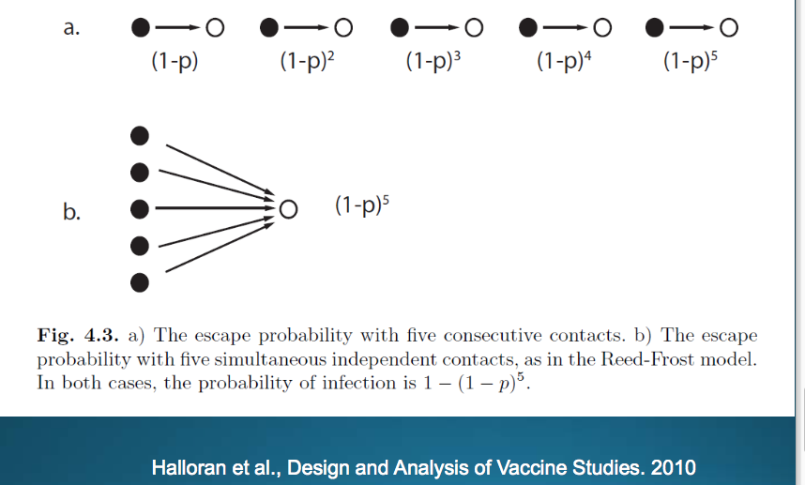
Chain Binomial Model

Slide 13
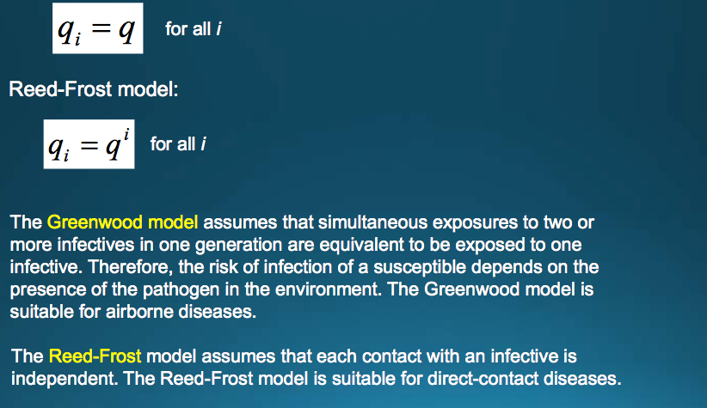
Chain Binomial Model

Slide 14

Chain Binomial Model
Only TOTAL infected individuals are simulated:
The probability of x infected individuals in the generation t+1 has binomial probability (q=1-p so this is binomial):
Update the infected individual at t+1
St+1=St-It+1
Rt+1=N-It+1-St+1 (optional)

